Slide 1
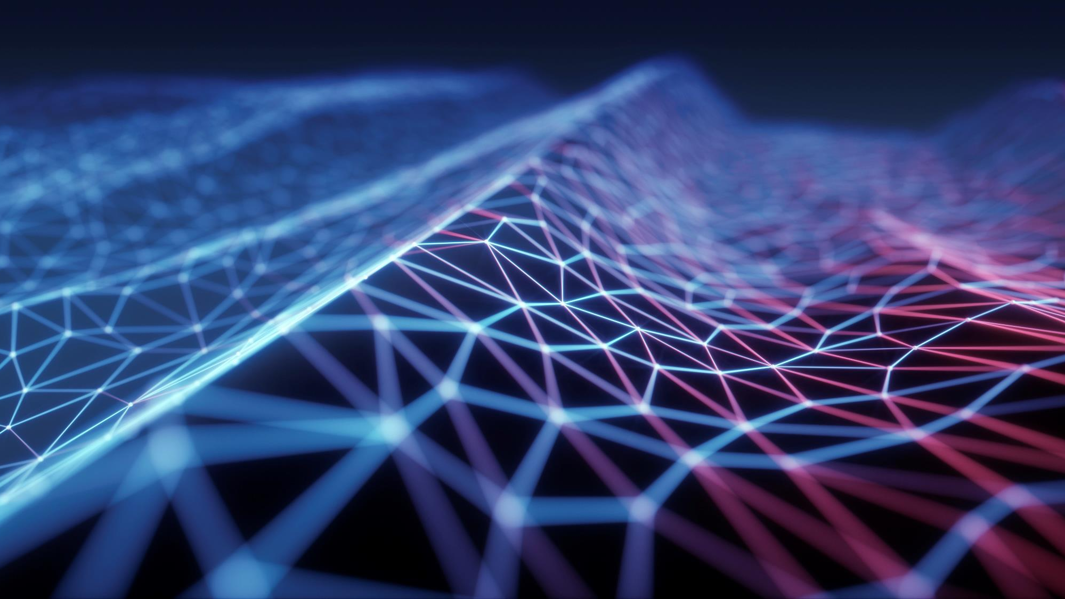
Seminar 5 – Future srm Trends – Machine learning
dd

Slide 2
Machine learning and automation
Practical applications are unlimited, imagine scenarios in which:
Systems can detect and respond to cyber attacks or attempts
Systems can identify areas of weaknesses before they are attacked
Systems can respond to such attacks autonomously and without human intervention
Systems can use behavioral analytics and AI/ML to detect new patterns

Slide 3
ConSTRAINTS and risks
Systems are just components of larger socio-technical systems and do not exist in isolation
They need to be designed with safety in mind
What if the logic is reversed? What if a defensive AI/ML system is hacked to be an offensive one?
How to train ML systems and avoid bad or poisoned training sets (Adversarial AI)?
How to deal with unknown shifts in the data domain or inferring incorrect patterns?
Issues of privacy, e.g. membership inference

Slide 4
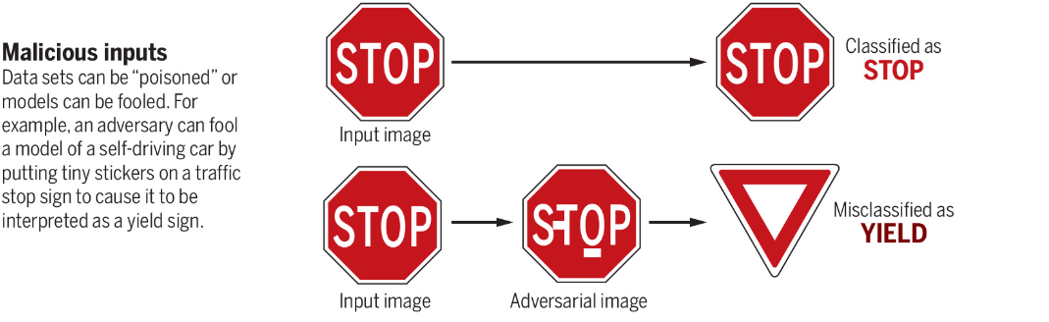
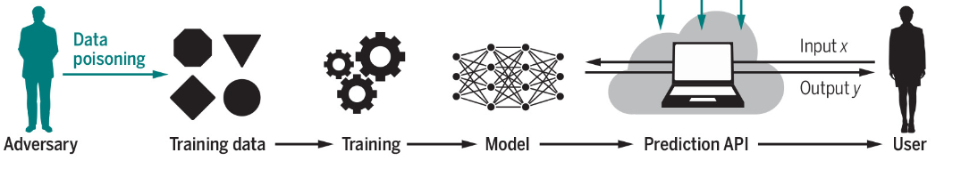
Examples (Eshete,2021)

Slide 5
Considerations for the future
The topic is wider than just IT or security
Wider implications for our society
Ethical questions and topics of fairness especially when ML is used to address human needs
Transparency and privacy are sometimes conflicting
Alignment of ML norms with human norms

